Slide 1
YOUNG PEOPLE DISCUSSION
Aktivita pro diskusi ve dvojicích nebo skupinách

Slide 2
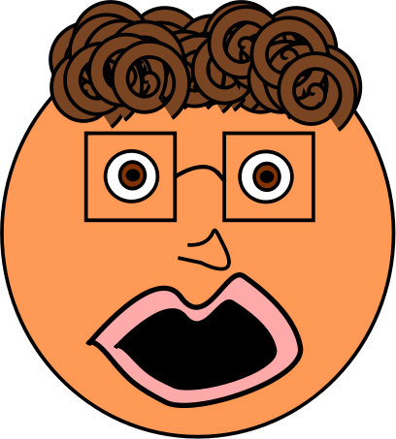
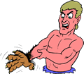
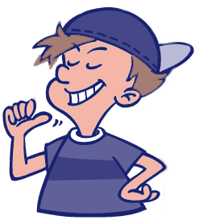


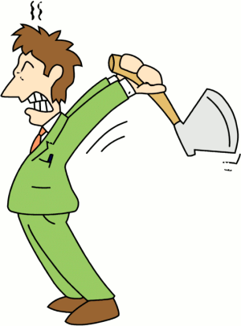
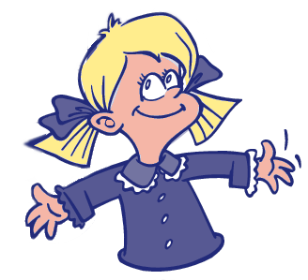
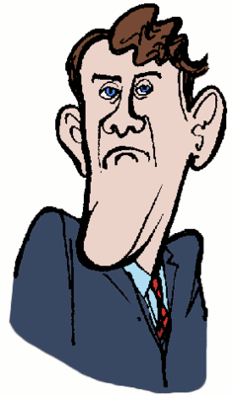
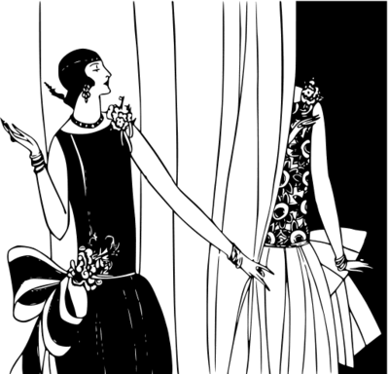
Problems of young people – can you identify them? – use your fantasy!!
Maybe it is..., it might be…

Slide 3
Was it difficult?
What about this:
Keeping fit – muscles thanks to steroids
Are nerds popular with other students?
Kids and violence
Computers – waste of time?
Authorities – do young people respect them?
Fashion – brand bully
Boastful boys, big mouths, big bosses, bullies
WHICH OTHER PROBLEMS WEREN´T MENTIONED?

Slide 4
Instrukce
Students use thier fantasy and try to identify problems depicted by the pictures.
Next slide helps them with answers
They are trying to come up with their own ideas about what is the lifestyle of young people, what bothers them…
Obrázky pocházejí z: http://www.pdclipart.org/displayimage.php?album=31&pos=185

